Slide 1
SEReNa
Software Engine for Relative Navigation
A Low-cost, High-precision Solution
for Autonomous Vehicles
Sung Moon Kang, PhD
kangs@sysense.com
2016 September 7
UAS Cluster Initiative Tech Forum

Slide 2
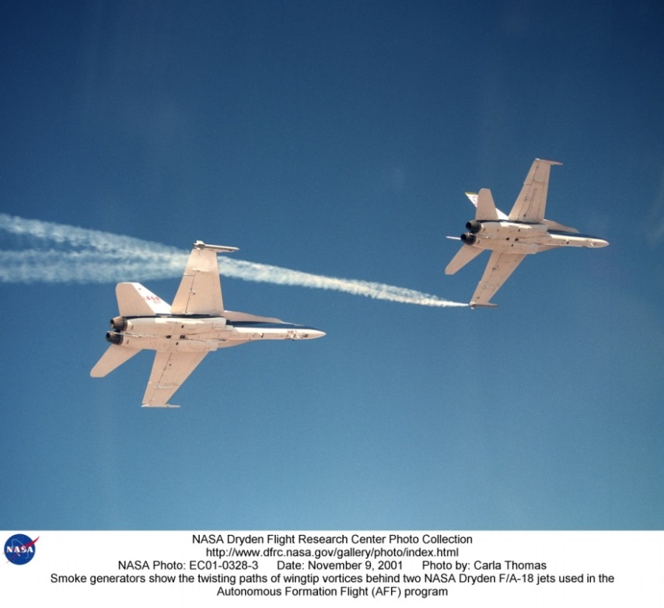
Relative Navigation Software
SEReNa is derived from our Formation Flight Instrumentation System
  Highly precise, real-time, robust
  relative navigation solution from
  RTK GPS solution
  Flew on two NASA Dryden
  (now Armstrong) Flight
  Research Center test planes
SEReNa is a hardware-
agnostic software solution
  Enables RTK GPS on
  small SWaP hardware

Slide 3
Why RTK GPS?
Technology | pros | cons
LiDAR, radar, ultrasonic sensors | immediate great for collision avoidance | limited range no sense of place in the world
camera, electro-optical sensors | fast can give orientation | computationally intensive sensitive to the environment no sense of place in the world
beacon tracking or following | doesn’t require line-of-sight | poor position accuracy only estimates distance no sense of place in the world
GPS | doesn’t require line-of-sight sense of place in the world | poor position accuracy
RTK GPS | doesn’t require line-of-sight high precision | two GPS receivers needed expensive

Slide 4
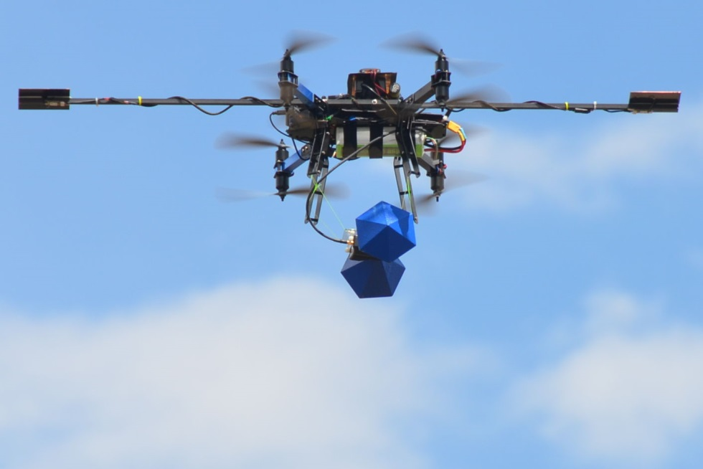
SEReNa™ : a new RTK GPS solution
Squeezes the value and power of sub-centimeter precise positioning into small unmanned vehicles
Reliable, useful performance with L1-only GPS hardware
  “Fix integers” within minutes,
  maintains fix, and “re-fixes”
  within seconds
  Demonstration platform using
  2.5 cm patch antennae and
  off-the-shell receivers
  Now you can put RTK GPS
  on drones
ECHO drone Arizona State University Low-frequency Cosmology Lab
2016 July 21 Embry-Riddle Aero - Prescott, AZ
Flown with SEReNa capable GPS receivers

Slide 5

Potential Uses of Precisely Positioned Drones
Precision mapping
Real-time 3D imaging
  Scan any structures knowing exactly where the
  camera is at all time; less image processing
Autonomous formation flight
  Stereoscopic vision from two drones
  Arrayed antenna
  Drag reduction
Other applications ….
SEReNa makes these potential uses all possible

Slide 6
A Joint Venture of SySense, Inc. & ASC Tech
SySense, Inc., El Segundo, CA
  Engineering R&D, specializing in relative navigation, guidance, and control of aerospace vehicles, fault detection, and adaptive control
  Principals: Jason L. Speyer (MIT , Harvard, National Academy of Engineering)
  Sung Moon Kang (Yale, Stanford, UCLA)
  Nhattrieu C Duong (Caltech, UCLA)
  Continues to work with NASA, Department of Defense, prime defense contractors on aerospace R&D projects
ASC Technology Group, LLC., El Segundo, CA
  Venture capital group supporting technology and business development
  Principals: Robert Lin, Don Trinagli

Slide 7
Development and Licensing Partners Sought
License the technology to multiple markets
  Phase Ruler™: our first product marketed
  for licensing
  SEReNa implemented as a point-to-point
  measuring system for the construction market
Partner is sought for implementation into
drones and unmanned vehicles
  Develop a “ready-to-go” package that can be
  added to any unmanned vehicle
  Integrate into production drones

Slide 8
SEReNa: RTK GPS for Drones
SEReNa is a hardware-agnostic software solution to a problem that has traditionally been solved by increasing hardware quality, cost, and SWaP
  Software is designed as a relative navigation solution to allow autonomous formation flight (or driving)
Licensing Partners sought
  Expertise and support to implement in UAS vehicles – design hardware package using off-the-shelf components
  Potential licensees are either drone manufacturers or distributors of drone systems, services, and accessories

Slide 9
Technical Briefing and Demonstration
Call us for a demonstration of SEReNa with
Phase Ruler™.
Sung Moon Kang, PhD | Robert “Bob” Lin
President / Senior Research Engineer | CEO
SySense, Inc. | ASC Technology Group, LLC
kangs@sysense.com | bob.lin@asctechnologygroup.com
310-322-7973 ext 1002 | 424-271-6500 ext 510

